Slide 1
Weekly report 1
Intrusion detection in containerized environment

Slide 2
Action items for this week (Covered papers)
Low-Level Exploitation Mitigation by Diverse Microservices (1)
A Game of Microservices : Automated Intrusion Response (2)
Container Security : Issues, Challenges and Road Ahead (3)

Slide 3
Achieved goals during this week
Basic idea of VM and containers
Use cases for container security
Different protection and tolerance mechanism
Many new terms

Slide 4
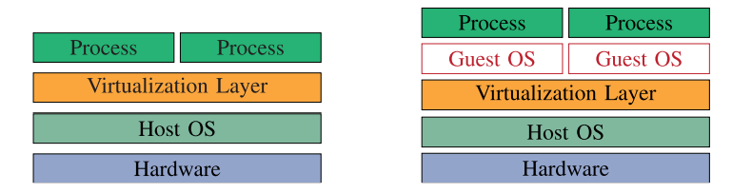
VM vs container
VM
Container
Separate OS for each process
More secured
Less suitable for microservice
Shared OS
Less secured
More suitable for microservice
a. Container
b. VM

Slide 5
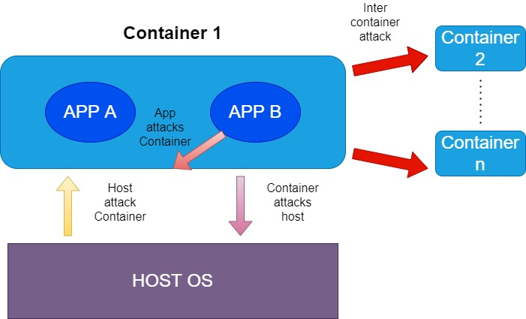
Use cases for container security
Protecting a container from applications inside it
Inter-container protection
Protecting the host from containers
Protecting containers from a malicious or semi-honest host

Slide 6
Tolerance techniques from paper (2)
Rollback
Rollforward
Diversification through recompilation and binary rewriting
Diversification through cloud provider
Scale up or down N-variant services
Split or merge services
Isolation or shutdown
Notes:
Paper(2):A Game of Microservices : Automated Intrusion Response

Slide 7
Protection mechanism from paper (1)
Maximizing API security: Exposed network interfaces must be minimal, have strong input validation.
Avoiding unnecessary node relationships.
Asymmetric node strength: The more secure nodes should be placed at critical network segments
Introducing security monitor services
Notes:
Paper(1): Low-Level Exploitation Mitigation by Diverse Microservices

Slide 8
Protection mechanism from paper (3)
Software based:
Linux Kernel Features:
Namespace: Isolates system resources among containers
Control Groups: Limits resource usage
Capabilities: Doesn’t give root privilege rather fine-grained access control to applications
Secure Computation Mode : Filters out unnecessary system calls
Linus Security Modules: AppArmor, LoadPin, SELinux, Smack, TOMOYO, YAMA, etc
Prevents essential kernel vulnerabilities (use case 1, 2, 3)
Notes:
Paper(3): Container Security : Issues, Challenges and Road Ahead

Slide 9
Protection mechanism from paper (3)
Hardware based:
Virtual Trusted Platform Modules(vTPM):
vTPM in host OS kernel (for honest and semi-honest host)
vTPM in dedicated container (for malicious host)
Intel SGX: Provides protection against controlled channel attack, BranchScope attack, Stealthy page-table based attack, etc
Notes:
Paper(3): Container Security : Issues, Challenges and Road Ahead

Slide 10
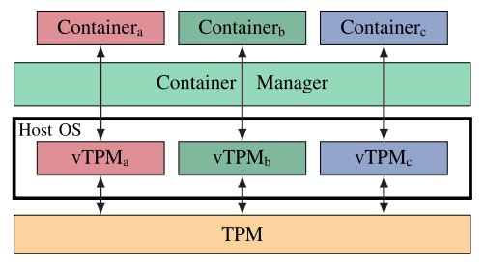
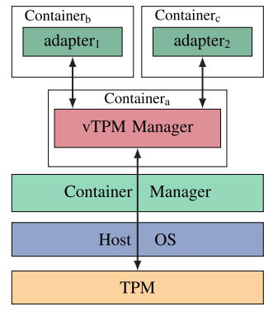
vTPM
This feature is mainly for honest and semi trusted OS
This feature is for malicious OS

Slide 11
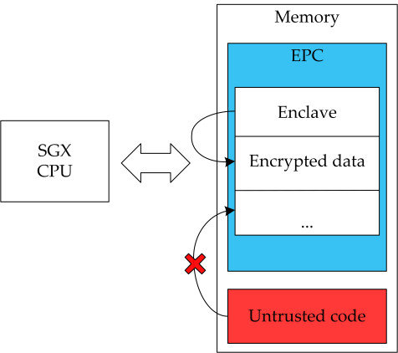
INTEL SGX(SOFTWARE GUARD EXTENSION)
The primary SGX abstraction is an enclave: an isolated execution environment within the virtual address space. It reduces the attack space for a malicious OS or application.

Slide 12
Other aspects of container security from Paper (3)
Standards for container security
Digital forensics for containers
Container alternatives (VM or unikernel)
Blockchain for container verification
Container specific LSM
Notes:
Paper(3): Container Security : Issues, Challenges and Road Ahead

Slide 13
Current road blockers/issues
Currently not facing any issues but some papers seem complex to understand.

